Slide 1
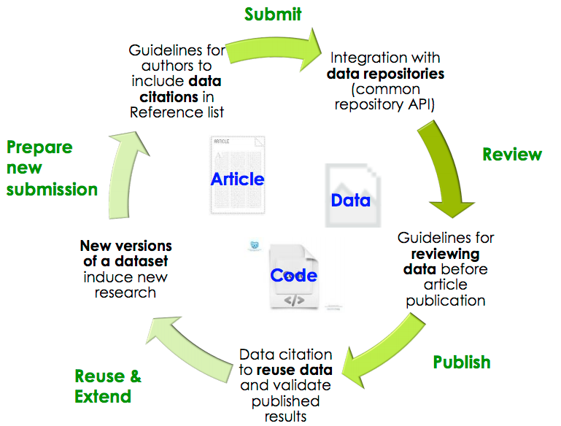

OJS + Dataverse: Integrated & Transparent Publishing Workflows
Eleni Castro, Research Coordinator > IQSS, Harvard
PKP AGM 2014 > October 3, 2014
Notes:
Working with journals, organizations that develop editorial software in an effort to move towards an integrated and transparent journal and data publishing workflow to improve access and discoverability of code + research data.
essential that the data supporting the results and, ultimately, the article conclusions be made publicly available with the article, thus enabling reproducibility and even reuse in some cases (F1000Research)

Slide 2

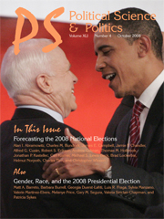
At the Policy-Level…
Data availability policies are not enough.
  Ghergina & Katsanidou 2013 study: 18/120 Pol Sci + IR journals have a replication policy, yet replication “is essential for the evaluation of the quality of a piece of work.”
Journals may not able to provide storage (Ishiyama 2014), long-term data management and preservation.
Notes:
Our initial motivation for this project was that simply at the policy level: data availability policies are not enough. Of the 18 as Ishiyama 2014 points out most of them give the author the responsibility to make the data available (upon request) not publicly accessible and guaranteed available in the long term.

Slide 3

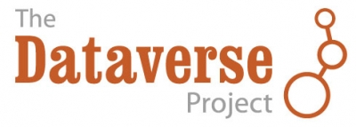
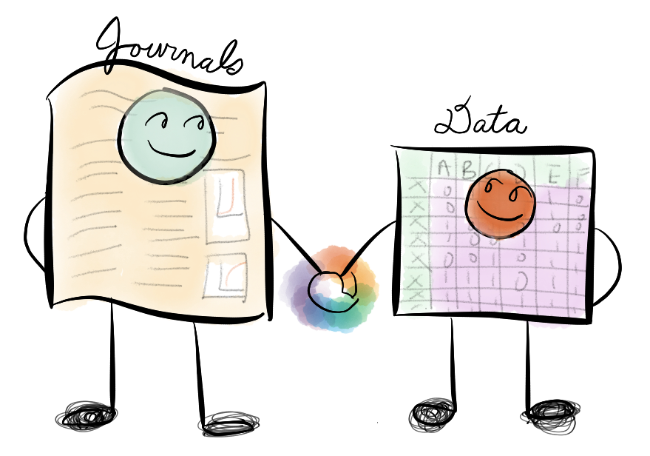
Policy + Technology
Developing technological solutions in editorial software and repositories can help reduce the rate of noncompliance with journal data availability policies.
+
Photo: Jean Liu

Slide 4
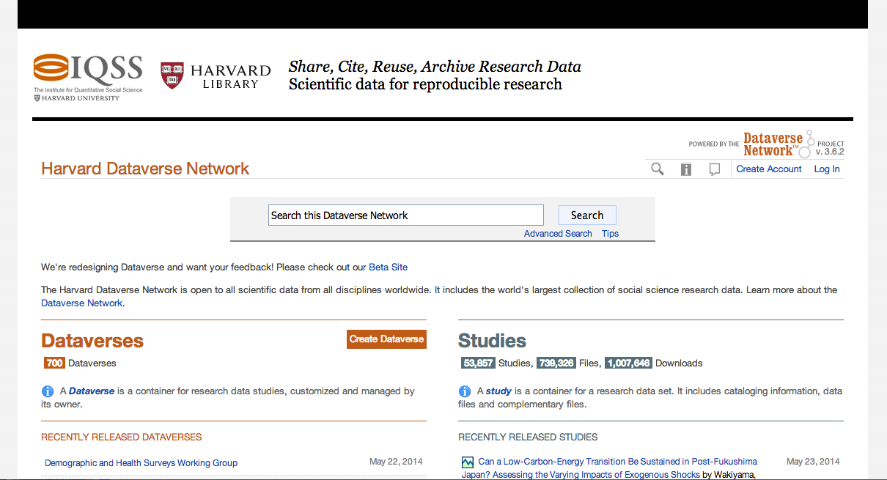
Introduction to Dataverse
Software framework for publishing, citing and preserving research data
(open source on github for others to install)
Provides incentives for researchers to share:
Recognition & credit via data citations
Control over data & branding
Fulfill journal data availability and funder requirements.
Harvard Dataverse (open to all; repository instance at Harvard) currently has:
761
Dataverses
> 1 Million Downloads
54,828
Datasets
748,554
Files

Slide 5


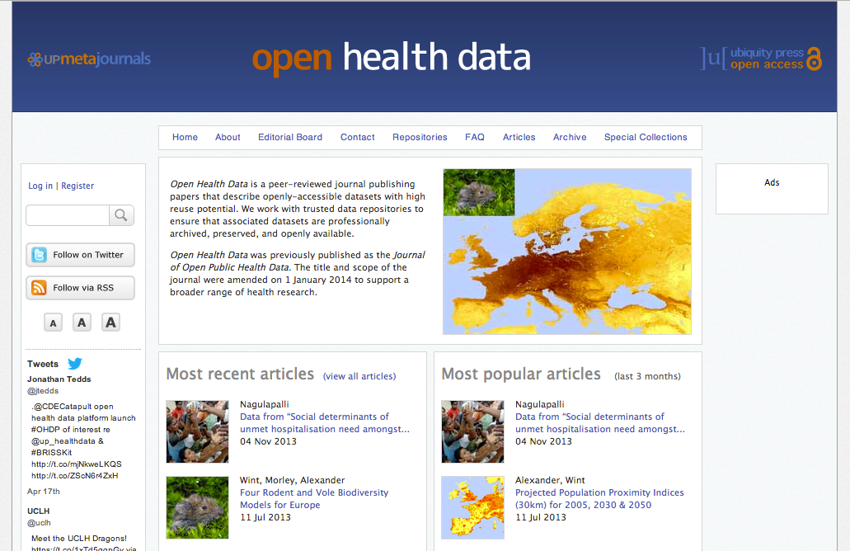
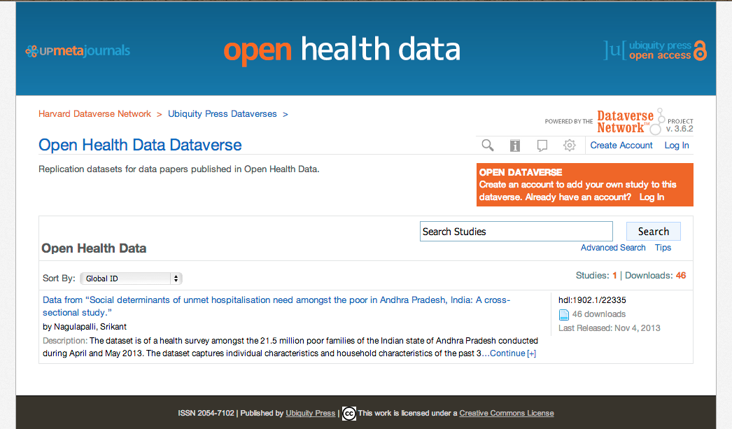
OJS-Dataverse Integration
OJS Journal
Journal Dataverse
Citation to Data
Citation
to Article
Details: 2 Year Project 2012-2014
Integrating w/ PKP’s Open Journal Systems (via SWORD API).
Pilot with ~ 50 journals + expanding outreach (hundreds) .
OJS’ Dataverse plugin now available with latest OJS release.
Future: Extend integration with Dataverse to OMP.
http://projects.iq.harvard.edu/ojs-dvn
Notes:
So what if the author could submit the paper and its underlying research data all on the same platform without having to submit each separately?

Slide 6
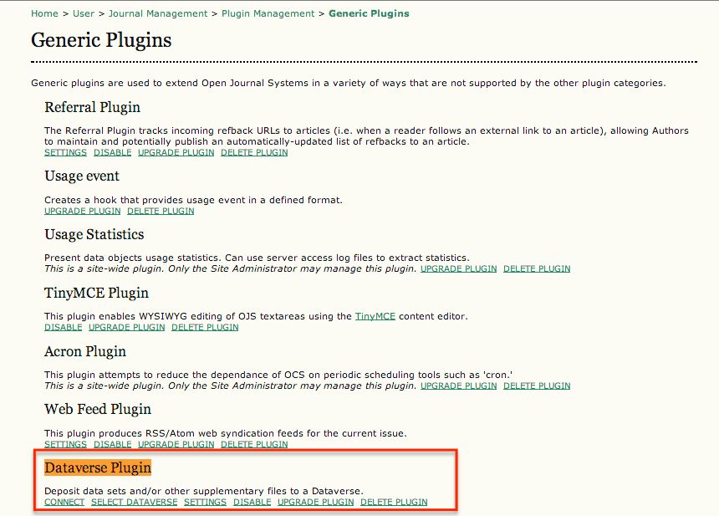
Journal Manager: Sets Up Dataverse Plugin
Notes:
Connect to Dataverse Network ->Select specific Journal Dataverse →Settings (when to submit data to Dataverse at article publication or acceptance)

Slide 7
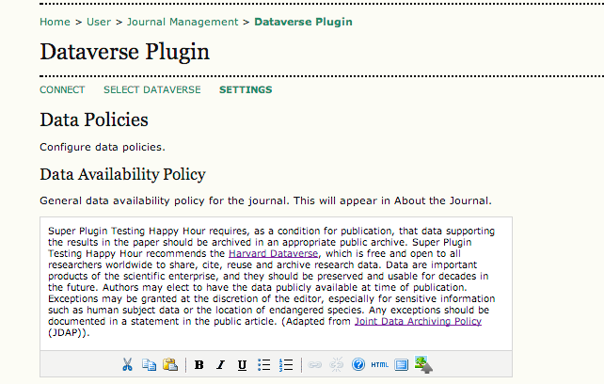
Journal Data Policies Boilerplate Templates
Including Guidelines for:
Authors (w/ data citation)
Reviewers
Read full Data Policies / Guidelines Template: http://bit.ly/1xkLjoZ
Notes:
Boilerplate policies for authors to deposit and cite data in OJS Dataverse plugin. Includes boiler plate for Reviewers and copyeditors.

Slide 8
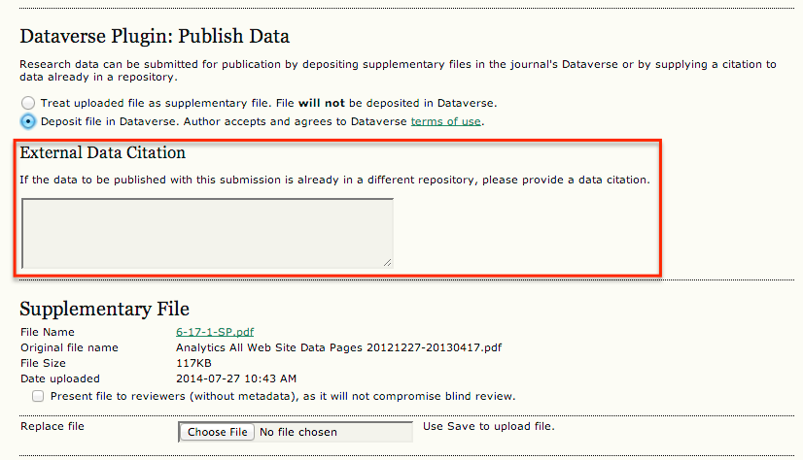
Author Manuscript + Data Submission
A
B
Option to: (A) deposit into Dataverse AND/OR; (B) if data is already in a repository can include the data citation (w/ persistent URL/identifier).
Notes:
This step would happen during Step 4: Supplementary File submission step.
Joint Declaration of Data Citation principles #3 In scholarly literature, whenever and wherever a claim relies upon data, the corresponding data should be cited

Slide 9
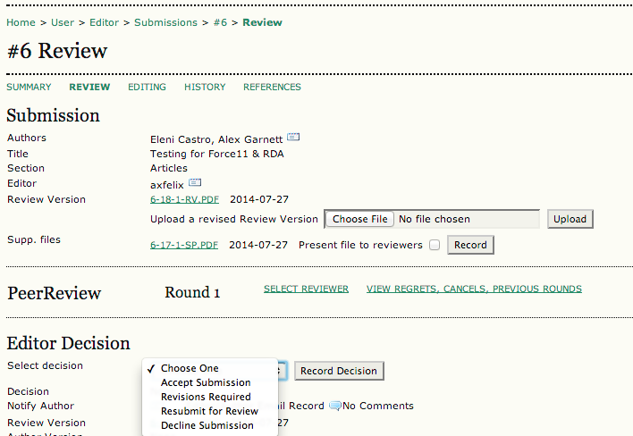
Peer Review: Article + Data Together
Notes:
. If article is not approved for publication the dataset (supp files) are removed from Dataverse and OJS.

Slide 10
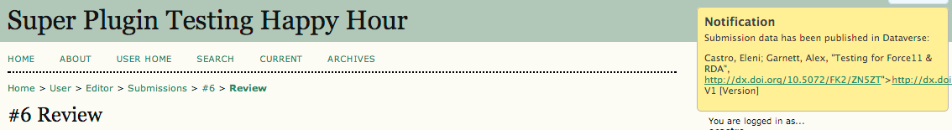
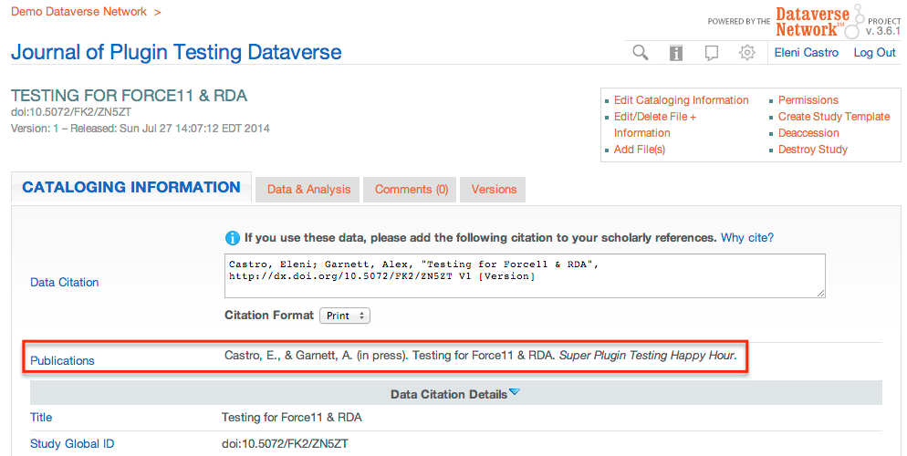
Data Published in Dataverse w/ OJS Plugin
In OJS:
In Dataverse:
2 Options in OJS:
1) Dataset Published (with DOI) at Article Approval.
2) Dataset Published when Journal Issue is Released.

Slide 11
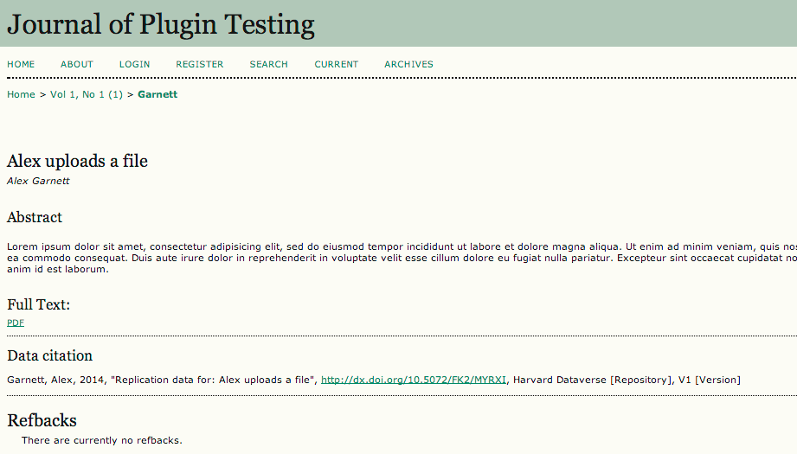
Article Published w/ Data Citation
Notes:
Now that the Data Citation is listed on the same page as the article it helps it go one step closer to data citation principle #1 Importance: Data citations should be accorded the same importance in the scholarly record as citations of other research objects, such as publications

Slide 12
But this is just the beginning…
We need input from you!
This is a reference implementation that we hope others can help expand and improve upon.
---------------
References
Gherghina, S., & Katsanidou, A. (2013). Data availability in political science journals. European Political Science 12: 333-349. doi:10.1057/eps.2013.8
Ishiyama, J. (2014). “Replication, Research Transparency, and Journal Publications: Individualism, Community Models and the Future of Replication Studies” PS:Political Science and Politics 41(1): 78-83. doi:10.1017/S1049096513001765
King, G. (2003). The future of replication. International Studies Perspectives, 4(1), 443-499.

Slide 13
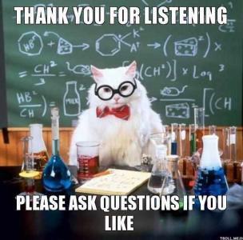
Thank you!
Contact: ecastro@fas.harvard.edu
More information: http://projects.iq.harvard.edu/ojs-dvn
Twitter: @thedataorg
Special Thanks & Credit To: Jen Whitney (PKP/Carleton: developed >90% of plugin code), Alex Garnett (PKP/SFU), Phil Durbin (IQSS), Sloan and the rest of the project team (PKP/IQSS) for making this project and presentation possible!

